Slide 1
4 Key points for each major transmitter
Transmitter | Location | Synthesis | Inactivation | Receptors
ACh | NMJs, ANS, tegmentum | Choline+Acetyl CoA ChAT | AChE | (i) nAChR (m) mAChR
Glutamate | >90% CNS synapses | Glutamine Glutaminase | EAATs | NMDA (NR) AMPA (GluA), KA (m) mGlu
GABA
DA
NE/Epi
5-HT
Peptides | hypothalamus, pituitary gland, gut | Pre and pro peptide precursors. Occurs in SOMA. Active transport | peptidases | metabotropic

Slide 2
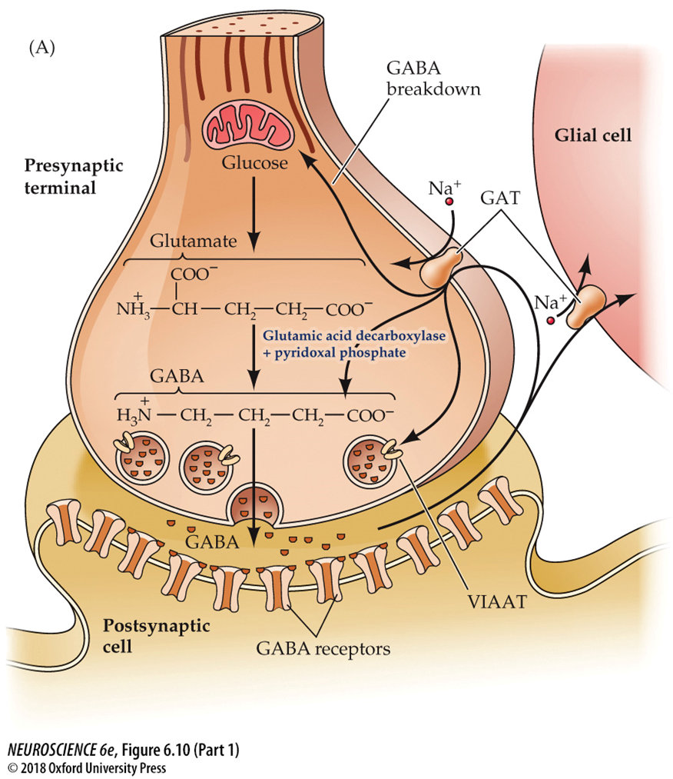
GABA

Slide 3

GABA Location and Synthesis
Located pretty much anywhere there are inhibitory neurons
Synthesized in axon terminals
Precursor:
  Glutamate!
  Glutamic acid decarboxylase (GAD) and pyridoxal phosphate convert glutamate into GABA
VGATs load GABA into vesicles
Notes:
1/3 of inhibitory synapses
GABA is most commonly found in local circuit interneurons, although medium spiny neurons of the striatum and cerebellar Purkinje cells are examples of GABAergic projection neurons.
GAD requires a co-factor
Derived from vitamin B6
deficiency of this vitamin can lead to diminished GABA synthesis and seizures
vesicular inhibitory amino acid transporter (VIAAT), also called the vesicular GABA transporter (VGAT

Slide 4
GABA Inactivation
Primarily accomplished through the activity of GABA Transporters (GATs)
  Reuptake to a glial cell or the presynaptic nerve terminal
  GABA transaminase converts GABA into succinic semialdehyde, which is further metabolized into other compounds
Notes:
Most GABA is eventually converted to succinate, which is metabolized further in the tricarboxylic acid cycle that mediates cellular ATP synthesis.
Two mitochondrial enzymes are required for this degradation: GABA transaminase and succinic semialdehyde dehydrogenase.

Slide 5
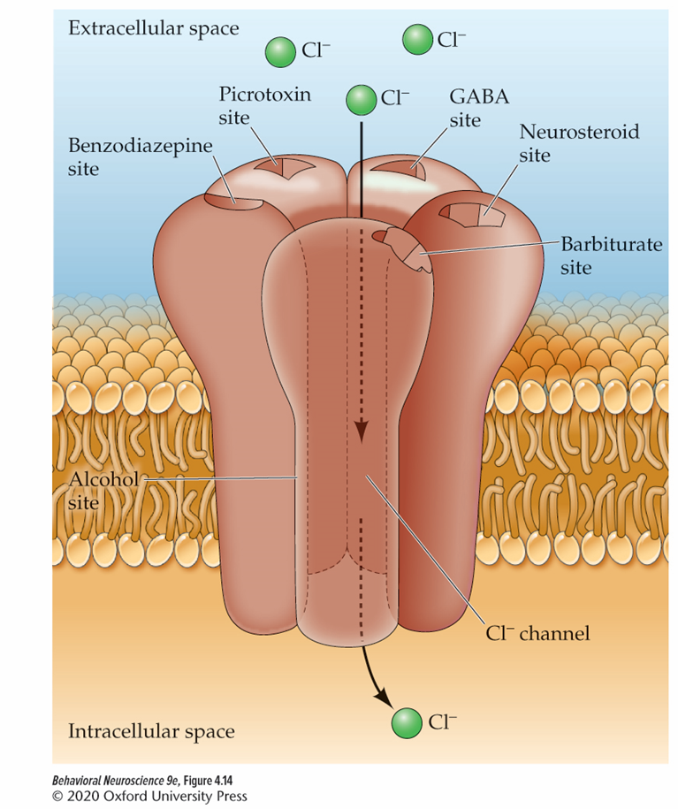
GABA receptors
GABAa
  ionotropic: ligand-gated Cl- channel
  5 subunits: typically 2α, 2β, γ
  Binding sites for benzodiazepines and barbiturates
  fast IPSP
GABAb
  metabotropic
  activation of K+ current or blockage of Ca²⁺ channels.
  slow IPSP
Notes:
There are 19 types of GABAA subunits
Benzos: Valium, Ambien. Bind to the antianxiety site; maximizes the time the pore is open and influences the frequency that the ion pore opens in response to GABA
Barbiturates mainly for anesthesia or epilepsy
Alcohol and Barbiturates Bind to the sedative-hypnotic site and increase the influx of Cl⁻, causing hyperpolarization

Slide 6
Biogenic Amines
Dopamine
Norepinepherine /Epinepherine
Serotonin
Notes:
Also histamine
Also called monoamines

Slide 7
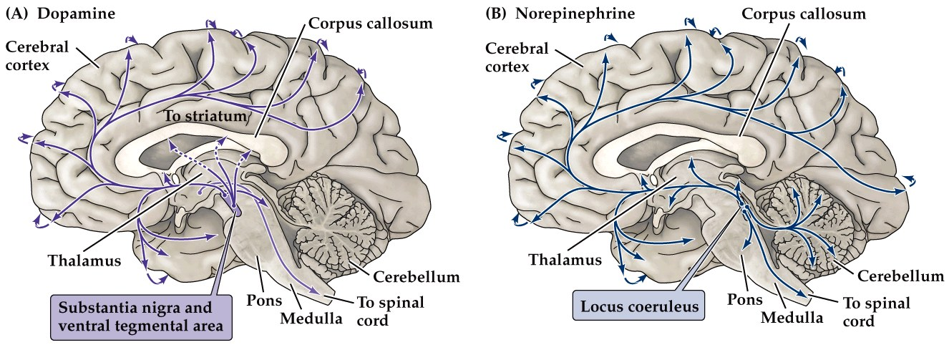
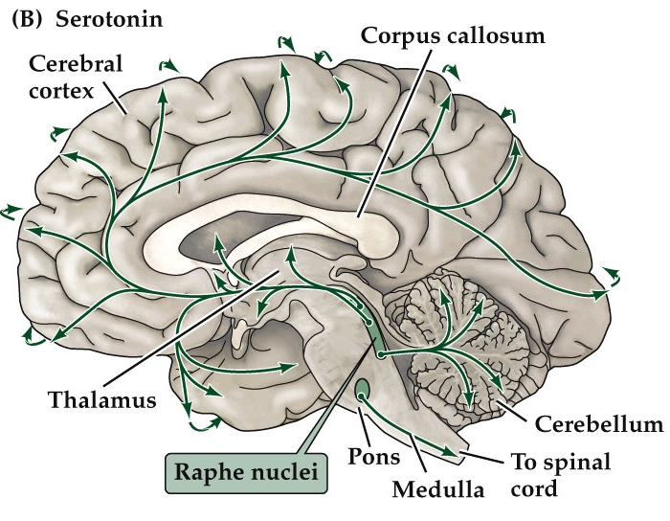
Locations
Notes:
Dopamine has several pathways related to reward and movement
NE has pathways for memory and sleep (Locus coeruleus) and PNS (Lateral tegmental area )
Epi mostly in LTA and medulla

Slide 8
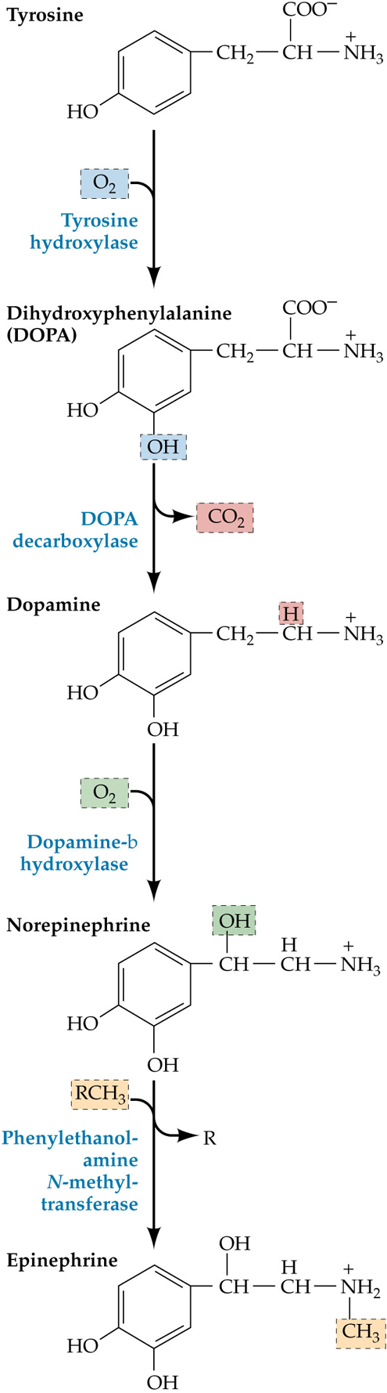
Synthesis and Inactivation:
Catecholamines
Synthesis:
  Synthesized in axon terminals
  tyrosine is a precursor shared by all catecholamines
    Tyrosine hydroxylase (TH) turns tyrosine into DOPA
    DOPA decarboxylase turns DOPA into DA
    Dopamine-b hydroxylase turns DA into NE
    Phenylethanol-amine N-methyl-transferase turns NE into E
  VMAT loads monoamines into vesicles
Inactivation:
  transporter proteins (DAT or NET).
  Reuptake to glial cells or the presynaptic nerve terminal
  MAO and COMT can break down catecholamines
Notes:
Dopamine NE and Epi
so named because they share the catechol moiety
VMAT = vesicular monoamine transporter
NET works for NE and E
catechol O-methyltransferase (COMT)

Slide 9
Dopamine (DA) Receptors
All metabotropic receptors
D1-like
  D1 & D5
  positively coupled to adenylyl cyclase (AC)
    stimulates formation of cAMP
D2-like
  D2, D3, D4
  negatively coupled to adenylyl cyclase
    inhibits formation of cAMP
Notes:
Adenyl cyclase: enzyme that converts ATP into cyclic AMP (cAMP)

Slide 10
NE/E α-Adrenergic Receptors
All metabotropic
α-Adrenergic receptors
  α1: slow depolarization
  α2: slow hyperpolarization, inhibit AC, ↓ cAMP
β-Adrenergic Receptors
  3 subtypes: β1, β2 & β3
  activation of AC, ↑ cAMP

Slide 11
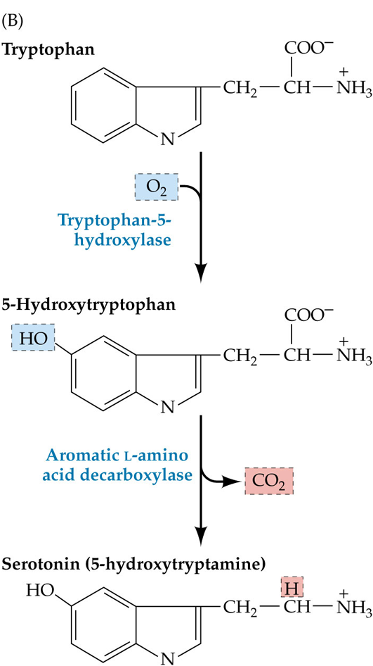
Serotonin Synthesis and Inactivation
Synthesis:
  Synthesized in axon terminal
  Tryptophan is the precursor
    Tryptophan-5-hydroxylase turns tryptophan into 5-hydroxytryptophan
    Aromatic L-amino acid decarboxylase turns 5-hydroxytryptophan into serotonin (5-hydroxytryptamine or 5-ht)
  VMAT loads 5-ht into vesicles
Inactivation:
transporter proteins (SERT).
  Reuptake to the presynaptic nerve terminal.
  MAO and COMT can break down 5-ht

Slide 12
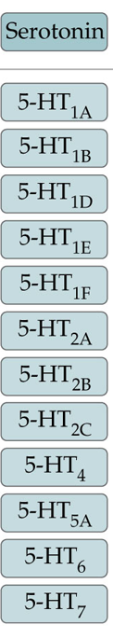
Serotonin (5-ht) Receptors
Ionotropic
  5-ht₃
    5 subunits that create a pore
    Non-selective cation (positive charge) channel
    Generates EPSP
Metabotropic
  Various effects

Slide 13





















Mood and temperature regulation, aggression, and sleep cycles
Serotonin
Main excitatory neurotransmitter; participates in relay of sensory information and learning
Motor function and reward
Glutamate
Dopamine
Neurotransmitters
Main inhibitory neurotransmitter
Acetylcholine
Muscle contraction (PNS) Cortical arousal (CNS)
GABA
Norepinephrine
Epinephrine
Brain arousal and other functions like mood, hunger, and sleep
Sympathetic activation (ANS)

